Slide 1




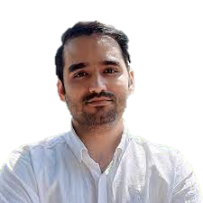



Edge-DIRECT: A Deep Reinforcement Learning-based Method
for Solving Heterogeneous Electric Vehicle Routing Problem with
Time Window Constraints
Arash Mozhdehi
Mahdi Mohammadizadeh
Xin Wang
arash.mozhdehi@ucalgary.ca
mahdi.mohammadizadeh@ucalgary.ca
xcwang@ucalgary.ca
Department of Geomatics Engineering, University of Calgary
Notes:
Hello everyone, my name is Arash. Today, I am presenting the paper titled "Edge-DIRECT”, a joint work sone at the University of Calgary with my colleague Mahdi and my supervisor Prof. Xin Wang.

Slide 2

Agenda
Motivation​
Literature Review
Proposed Method (Edge-DIRECT)​
Experimental Results​
Conclusion and Future Works​
Notes:
First, I will start by going over the motivation underling our work.
Then, I will briefly go over the existing methods for solving VRPS.
I will present our proposed method, named Edge-DIRECT.
After that I will show the result of some of the experiments.
Finally, I will conclude and present some future works directions.

Slide 3
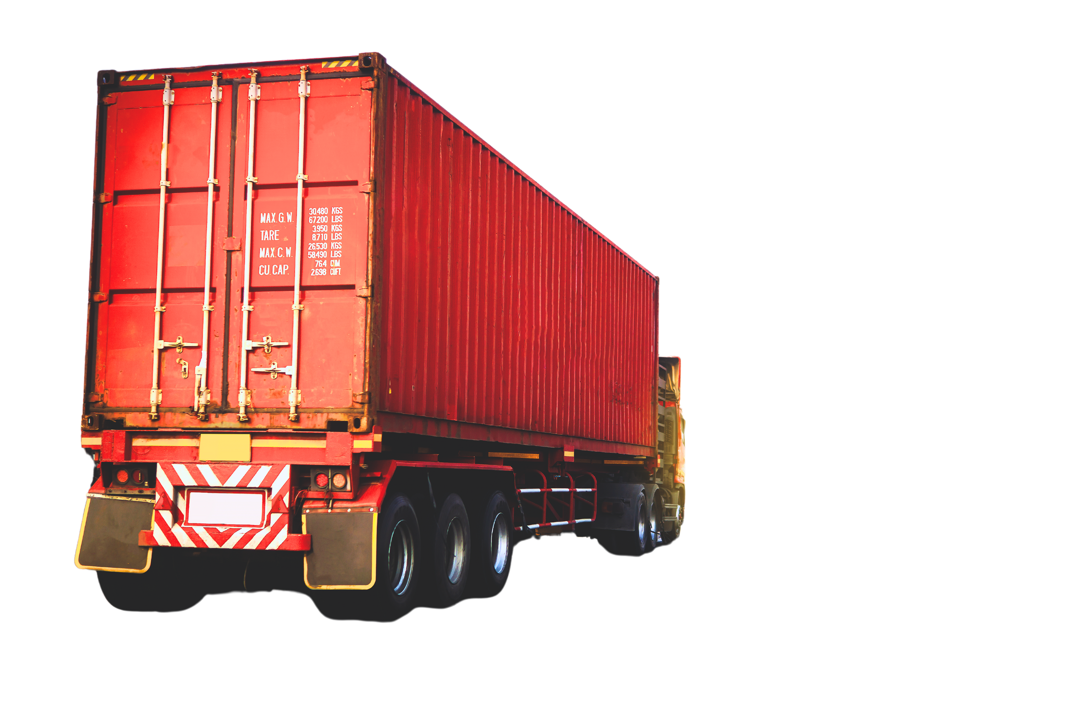

Motivation (Why VRP?)
Distribution costs make up almost 50% of total logistics operations costs.
Vehicle routing problems (VRP) is a crucial optimization problem aiming at minimizing the distribution costs.
Notes:
First, let’s start with why VRP is important.
According to the studies, almost half of Distribution costs goes to logistics operations costs, which itself has significant share in last-mile delivery.
VRP emerges as an important problem for minimizing these costs.
The are various variants of VRP taking different constraints and considerations into account among which HFEVRPTW plays significant importance for the last-mile delivery.

Slide 4

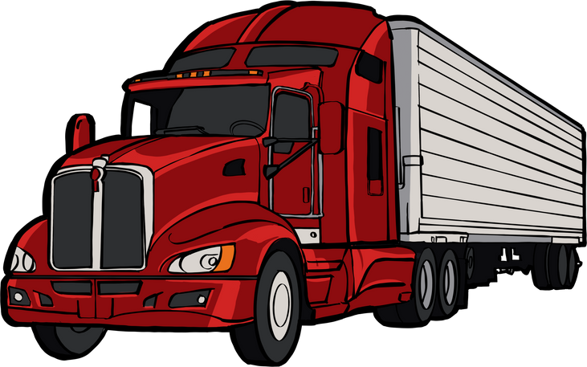


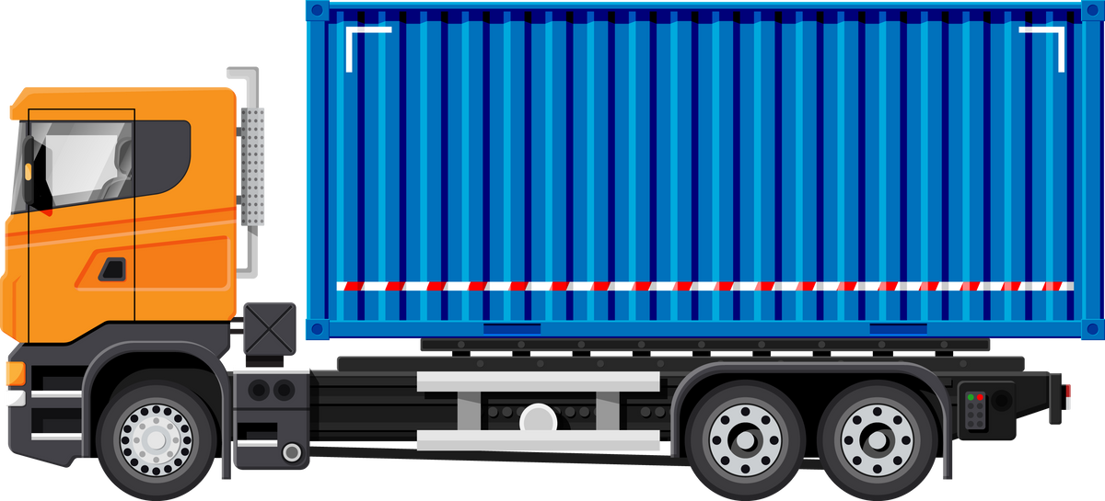



Motivation (Why HFEVRPTW?)
Recently, logistics companies are increasingly adopting medium- and heavy-duty electric vehicles in their fleets
Governmental incentives
New regulations
In real world operations, companies often employ heterogenous fleet
Cargo capacity
Battery capacity
Customers often set time-windows for their demands
In-house policies
Traffic regulations
Notes:
Among VRPs heterogeneous fleet electric vehicle routing problem with time window constraints (HFEVRPTW) emerges as crucial problem for the last-mile delivery.
In the recent years, more and more logistics companies, especially in Canada, consider employing EVs in their fleet, owing to on the one hand increased pressure from the governments for reducing carbon emission and incentives in replacing their rigs with ICE with zero emission ones.
Another important consideration that is included in HFEVRPTW is the fact in the real-world operations the vehicles vary in their size and battery capacity.
Finally, customers often set time-windows for their demands and that is sue to traffic conditions and regulations based on where the customer is located and well as in-house policies that customers have.

Slide 5




Motivation (What is HFEVRPTW?)
Objective: Minimizing total travel time/distance
Constraints:
Time-Windows
Heterogenous fleet’s
Cargo capacity
Battery capacity
Parameters:
Customers’ demand
Locations
Travel time/distance between nodes
Notes:
HFEVRPTW seeks to determine a set of routes with minimal cost, total traveling time, or total traveling distance, for a fleet of Heterogeneous EVs to serve each geographically dispersed customer’s demands within a specified time window. The heterogeneity of vehicles is with regards to their cargo capacity how much weight they can carry and the battery capacity which is a constraint differentiate EVs from ICEs due to the limited battery capacity.

Slide 6



Literature Review (Solving VRPs)
Conventional methods
Exact solvers
Pros:
Globally optimal solution
Cons:
Exponential worse case complexity
Heuristics solvers
Pros:
Faster than exact ones
Cons:
Manually-engineered search rules
Lack of generalizability and adaptability
Notes:
Traditionally, VRPs in general are solved through either exact solvers of heuristics based approximate solvers.
While the exact algorithms find the best solution, their use is limited to small-sized problems due to the infeasibility of solving problems with exponential computational complexity. However, in real-world operations companies deal with lots of deliveries in day.
Heuristic solvers, on the other hand, trade optimality for speed. However, they need cumbersome manual search rule engineering and lack generalizability and adaptability underscored by the "no free lunch" theorem.

Slide 7
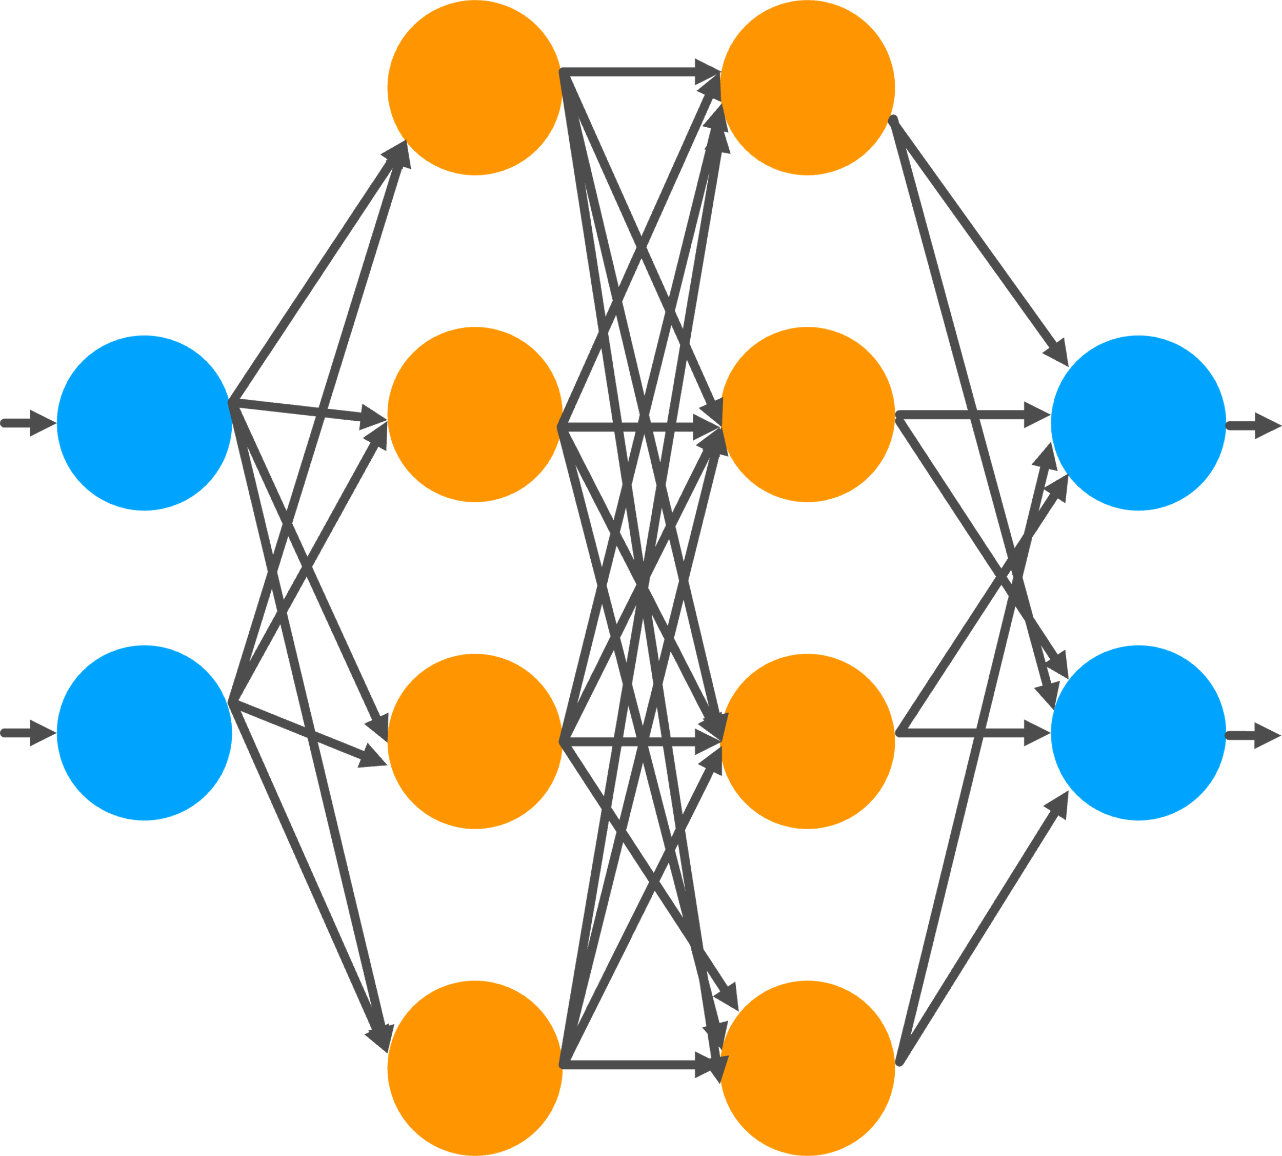
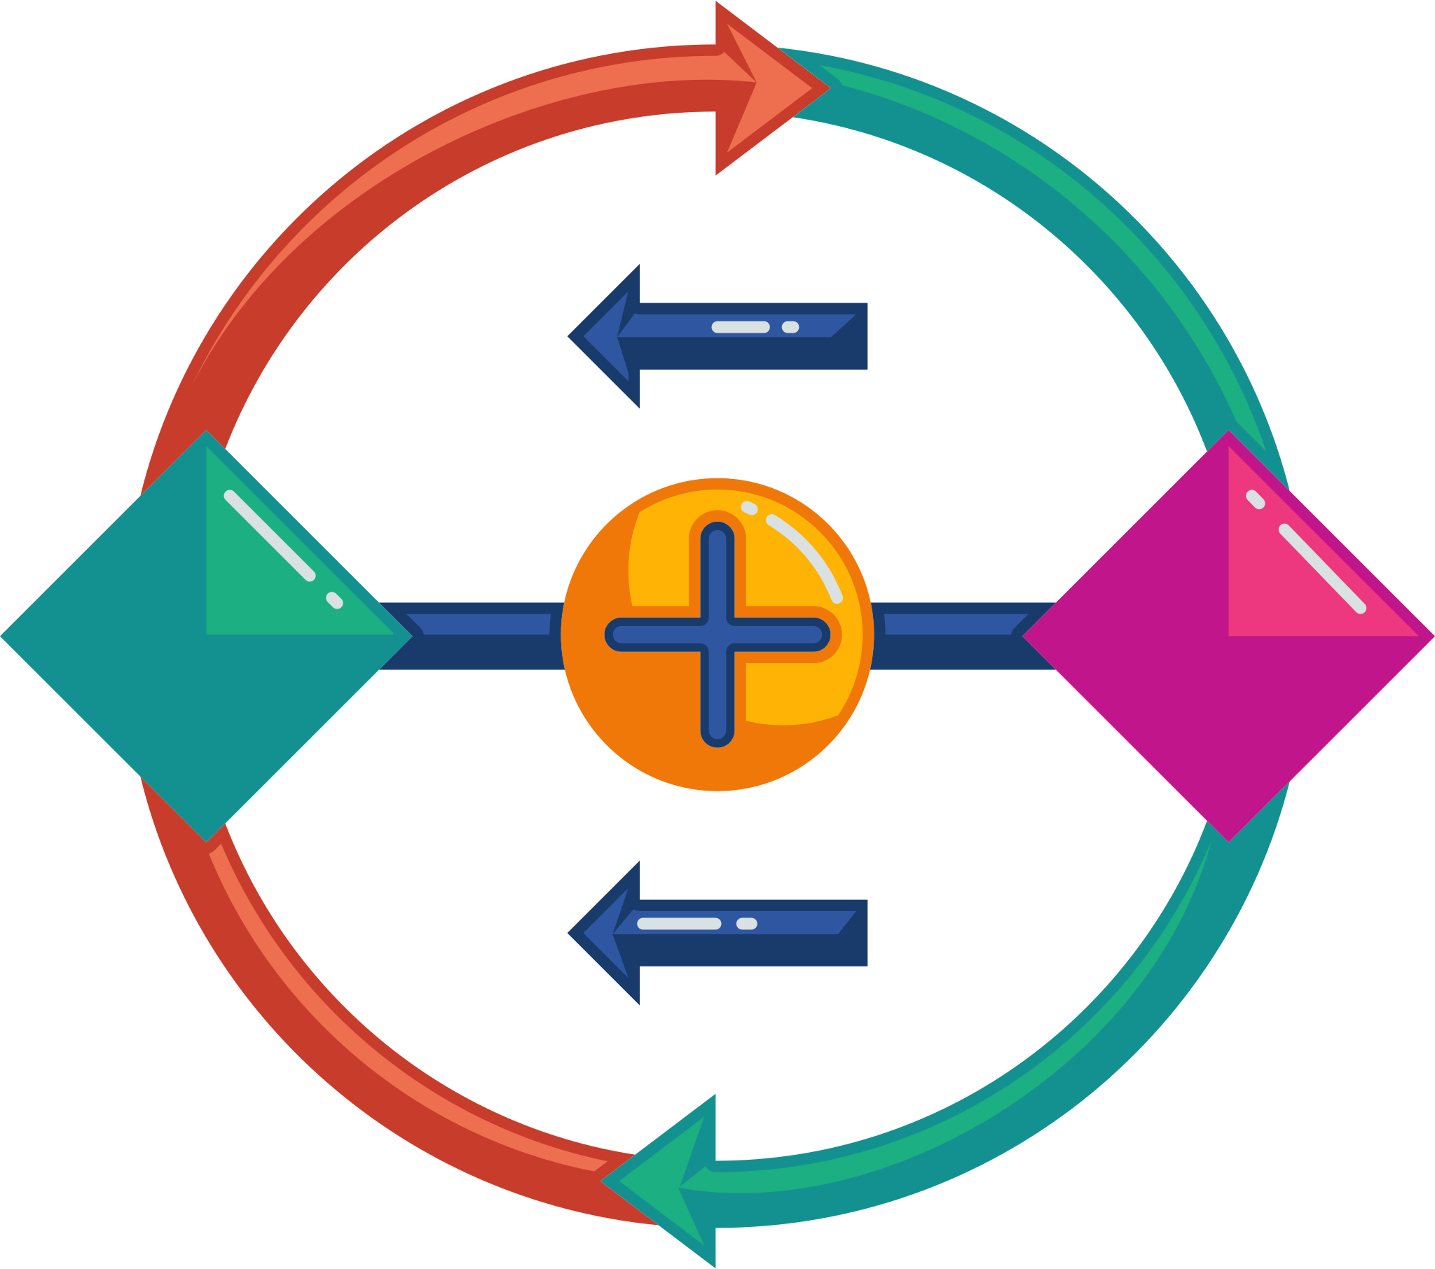
Literature Review (Solving VRPs)
Supervised deep learning-based methods
Pros:
Automatic search rules generation
Cons:
Solving in advance
Deep reinforcement learning-based methods
Pros:
Automatic search rules generation
No in advance solving
Notes:
Deep learning-based approximate solver learn the search rules automatically but require solving in advance and the performance is bounded by the quality of these solutions.
Deep reinforcement learning-based methods overcome the shortcoming of supervised fashion training by using the total cost as feedback.
Among DRL-based methods those featured with Transformer-style policy model stands out for outperforming competitive heuristics in terms of solution quality and computational time.

Slide 8



Literature Review (Current DRLs' limitations)
Ineffectiveness in solving HFEVRPTW, due to:
Failure to recognize node reachability
Inability to capture the vehicles’ heterogeneity
Failing to exploit energy consumption
8 AM – 11 AM
3 Hs
1 H
3 Hs
3 Hs
X kWh
3 PM - 5 PM
1 PM - 3 PM
Y kWh
2 Hs
1 H
2 PM - 4 PM
Notes:
Despite the effectiveness of these existing methods in solving simple VRPs, they fail to effectively solve HFEVRPTW due to the following limitations:
1st they fail to capture to underlying structure of the problem in accordance with time-window constraints and unrealistically assume all the customers are connected, ignoring the fact that some are unreachable from each other based on the time-window overlap and travel time between them.
2nd another shortcoming lies in their failure to capture the vehicle’s heterogenous features which play an important role when decisions should be made based on the remaining cargo and battery level of the vehicles for HF case.
Their 3rd important shortcomings is in their failure to capture the energy required for traveling between location this often ignore for the ICE-based VRP because of their large fuel tanks and capacity to cover significant distance in each refuel. However, the distance that can be covered by EVs is much shorter due to the limited capacity of their batteries, especially during the cold winters in Canada.

Slide 9
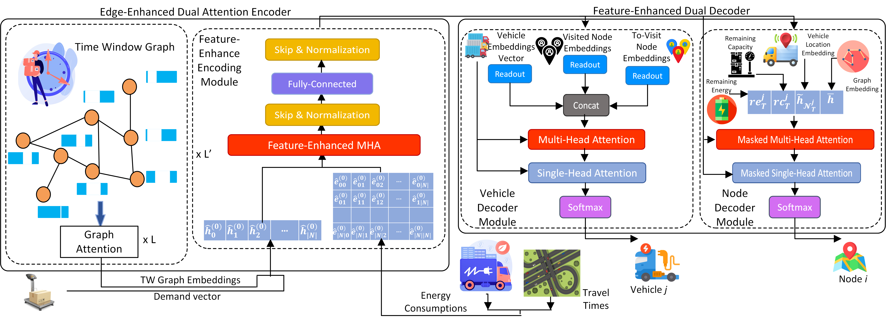
Proposed Method (Edge-DIRECT’s Framework)​
A novel method with Transformer-style policy model, named, Edge-enhanced Dual attentIon encoderR and feature-EnhanCed dual aTtention decoder (Edge-DIRECT).
Notes:
Here, you can see the overall architecture of the policy model, which has a Transformer-style architecture, comprising an encoding and a decoding module.
I’ll elaborate on the framework in the following slides.

Slide 10

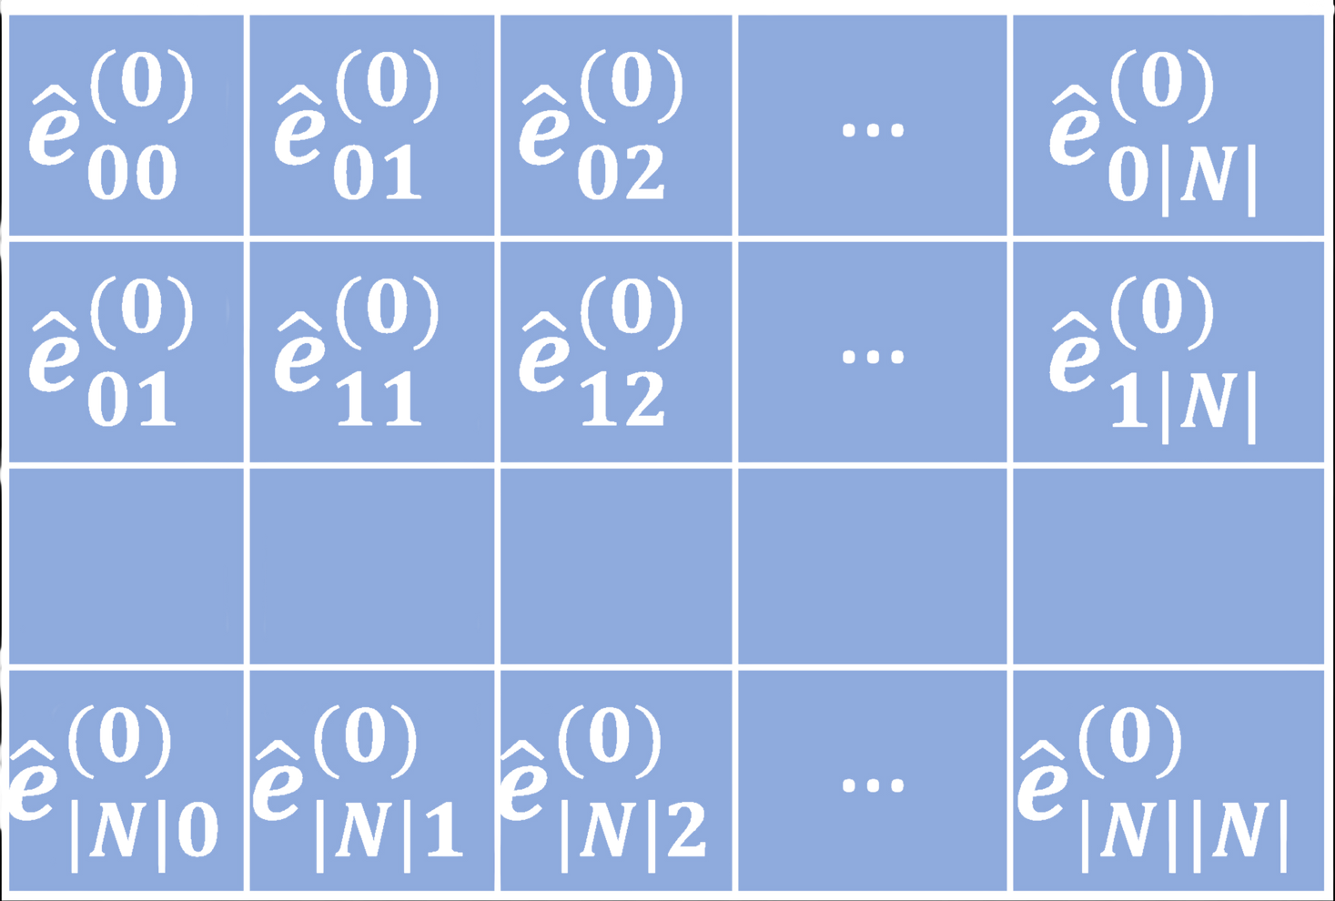




Proposed Method (Edge-DIRECT’s Encoding module)​
Skip Connection
&
Batch Normalization
Constructing Time-Window Graph
Edge-Feature Enhanced MHA
Initially Embedded Edge Features
Initially Embedded Node Features
Fully-Connected Layer
Skip Connection
&
Batch Normalization
Node Features
Edge Features
Charging Stations
Node Embeddings
Travel Time
Energy
Demand
Notes:
The encoding starts with forming the time window graph based on the constraints and capturing its underlying structure though graph attention.
Afterwards, the extracted features with the weight of the are passed to a self-attention-based encoder along with the energy consumption and travel time between the nodes as an edge features comprising the time and energy required for traveling between the nodes using a MHA-based encoder capture the dependencies between the nodes.

Slide 11






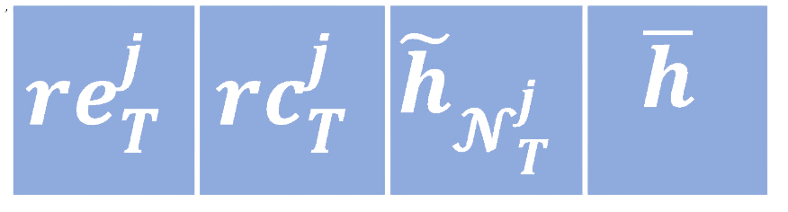




Proposed Method (Edge-DIRECT’s Decoding module)​
Unvisited Embeddings
Visited Embeddings
Vehicles' Embeddings
Softmax
Node i
Single-Head Attention
Readout
Readout
Readout
Concat
Multi-Head Attention
Multi-Head Attention
Graph Embedding
Remaining Energy
Single-Head Attention
Remaining Capacity
Vehicle j’s
location Embeddings
Softmax
Vehicle j
Notes:
Following the encoding process, the node embeddings and the graph embeddings are passed to the decoder.
The decoding process starts a vehicle selection decoder where the heterogonous features of vehicles captured and passed though an attention-based decoder for selecting a vehicle in the fleet to expand its routes.
Following the vehicle selection decoding, another context embedding is formed to select the next node be visited by the chosen vehicle through another attention-based decoder.

Slide 12


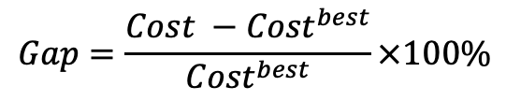
Experimental Results (Settings)​
Dataset: Based on two major Canadian cities
Edmonton
Calgary
Baseline:
Ant Colony Optimization (ACO)
Variable Neighborhood Search / Tabu Search (VNS/TS)
EVRPTW-RL
Metrics
Cost (Total travel time)
Computational Time
Gap
Edmonton
Calgary
$$Gap=\frac{Cost −{Cost}^{best}}{{Cost}^{best}}×100\%$$
Notes:
We preformed experiments on Edge-DIRECT and 3 baselines, two competitive heuristics VNS/TS and ACO and a SOTA DRL-based method proposed for solving EVRPTW, to address 3 research questions.

Slide 13
Experimental Results (RQ1)​
RQ1: How does Edge-DIRECT perform compared to the state-of-the-art DRL-based and heuristics methods in solving the HFEVRPTW in terms of the aggregated travel time and computational time on Calgary dataset?
Problem Sizes | HFEVRPTW -20 |  |  | HFEVRPTW -50 |  |  | HFEVRPTW -100
Models | Cost | Gap | Time | Cost | Gap | Time | Cost | Gap | Time
ACO | 678.6 | 5.60% | 7.4 min | 1405.9 | 15.08% | 41.8 min | 3133.7 | 24.64% | 2.8 h
VNS/TS | 642.6 | 0.00% | 6.6 min | 1222.5 | 0.00% | 54.4 min | 2514.2 | 0.00% | 15.8 h
EVRPTW-RL (Greedy) | 755.1 | 17.50% | 1.81 s | 1639.9 | 34.12% | 9.6 s | 4000.1 | 59.10% | 22.06 s
EVRPTW-RL (Sampling) | 689.2 | 7.25% | 16.1 min | 1392.3 | 13.89% | 1.6 h | 3230.7 | 28.49% | 3.5 h
Edge-DIRECT (Greedy) (ours) | 704.2 | 9.58% | 1.51 s | 1441.4 | 17.90% | 4.34 s | 3113.6 | 23.84% | 11.10 s
Edge-DIRECT (Sampling) (ours) | 660.5 | 2.78% | 5.6 min | 1273.4 | 4.16% | 25.8 min | 2699.7 | 7.37% | 1.8 h
Notes:
1st how well it perform ... ?
As perceivable through the table Edge-DIRECT outperforms all 3 in terms of computational time and perform comparability compared to VNS/TS while demonstrating better performance compared to the rest.

Slide 14
Experimental Results (RQ1)​
RQ1: How does Edge-DIRECT perform compared to the state-of-the-art DRL-based and heuristics methods in solving the HFEVRPTW in terms of the aggregated travel time and computational time on Edmonton dataset?
Problem Sizes | HFEVRPTW -20 |  |  | HFEVRPTW -50 |  |  | HFEVRPTW -100
Models | Cost | Gap | Time | Cost | Gap | Time | Cost | Gap | Time
ACO | 486.4 | 5.34% | 16.3 min | 1208.3 | 16.42% | 48.1 min | 2478.5 | 23.96% | 2.6 h
VNS/TS | 461.7 | 0.00% | 6.6 min | 1037.8 | 0.00% | 56.2 min | 1999.2 | 0.00% | 11.6 h
EVRPTW-RL (Greedy) | 537.6 | 16.43% | 1.76 s | 1340.6 | 33.21% | 23.7 s | 3213.9 | 60.75% | 23.7 s
EVRPTW-RL (Sampling) | 491.1 | 6.36% | 17.1 min | 1177.4 | 13.42% | 1.7 h | 2641.3 | 32.11% | 3.5 h
Edge-DIRECT (Greedy) (ours) | 506.8 | 9.76% | 1.48 s | 1212.5 | 16.83% | 4.58 s | 2419.6 | 21.02% | 11.47 s
Edge-DIRECT (Sampling) (ours) | 479.5 | 2.94% | 5.3 min | 1081.3 | 4.19% | 25.1 min | 2138.1 | 6.94% | 1.7 h
Notes:
1st how well it perform ... ?
As perceivable through the table Edge-DIRECT outperforms all 3 in terms of computational time and perform comparability compared to VNS/TS while demonstrating better performance compared to the rest.

Slide 15
Experimental Results (RQ2)​
RQ2: How do the time-windows encoding module, edge-enhanced encoding module, and dual attention decoder contribute to improving solution quality for the HEVRPTW?
Problem Sizes | HFEVRPTW -20 |  | HFEVRPTW -50 |  | HFEVRPTW -100
Model | Cost | Time | Cost | Time | Cost | Time
Edge-DIRECT w/o EE | 718.4 | 1.29 s | 1385.5 | 3.64 s | 3485.3 | 9.31 s
Edge-DIRECT w/o TWE | 742.1 | 1.03 s | 1449.3 | 3.08 s | 3278.7 | 7.73 s
Edge-DIRECT w/o HD | 738.5 | 1.13 s | 1445.5 | 3.22 s | 3296.7 | 8.02 s
Edge-DIRECT | 704.2 | 1.51 s | 1441.4 | 4.34 s | 3113.6 | 11.10 s
Notes:
The next RQ is related to the contribution of each of one of the module.
The table demonstrates that the TWE has the highest contribution for decreasing the total cost followed by dual decoder and edge-enhanced encoding.

Slide 16
Experimental Results (RQ3)​
RQ3: How do varying ratios of the number of charging stations to the number of customers impact the results?
Ratio | 2 % |  | 5 % |  | 10 % |  | 20 %
Model | Cost | Time | Cost | Time | Cost | Time | Cost | Time
EVRPTW-RL | 4024.1 | 15.78 s | 4018.1 | 15.83 s | 4000.1 | 15.98 s | 3987.4 | 17.31 s
Edge-DIRECT (ours) | 3201.5 | 8.18 s | 3165.2 | 8.24 s | 3113.6 | 8.32 s | 3068.3 | 8.65 s
Notes:
In the last RQ we investigate the effect of changing the charging stations to the customers ratios an see that the gap between ED and EV increases as the ration deceased favoring ED.

Slide 17
Conclusion and Future Works​
Conclusion
Propose an end-to-end DRL-based method with Transformer-style policy model, named Edge-DIRECT, for solving HEVRPTW
Introduce a graph-based representation for TW and graph attention layer to capture the structure.
Propose a decoder to capture EVs’ heterogeneity.
Introduce an enhanced encode and decoder model for exploiting energy consumption.
Outperform a STOA DRL-based approach, called EVRPTW-RL, and a competitive heuristic, i.e. ACO in terms of total travel time and running time. Preform competitively on total cost with VNS/TS while require much lesser computational time.
Future Works​
Take the non-linearity in charging time into account
Accommodate the potential for order cancellations
Notes:
To conclude,
.....
For the future research directions, here we assumed that charging time linear, in the future study we plan to take the non-linearity of charging time into account.
Another research direction can be considering the the possibility that the orders might be cancelled and work on how to handle this stochasticity.

Slide 18
References
[1] Shahabi-Shahmiri, Reza, et al. "A routing and scheduling problem for cross-docking networks with perishable products, heterogeneous vehicles and split delivery." Computers & Industrial Engineering 157 (2021): 107299.
[2] Klein, A. J. "Microcomputer-based vehicle routing and scheduling: An overview." (1987).
[3] Taş, Duygu, Ola Jabali, and Tom Van Woensel. "A vehicle routing problem with flexible time windows." Computers & Operations Research 52 (2014): 39-54.
[4] Golden, Bruce L., and Edward A. Wasil. "OR Practice—Computerized Vehicle Routing in the Soft Drink Industry." Operations research 35.1 (1987): 6-17.
[5] De Backer, Bruno, et al. "Local search in constraint programming: Application to the vehicle routing problem." Proc. CP-97 Workshop Indust. Constraint-Directed Scheduling. Schloss Hagenberg Austria, 1997.

Slide 19



Thank you
Code
Email
Arash Mozhdehi
arash.mozhdehi@ucalgary.ca
Mahdi Mohammadizadeh
mahdi.mohammadizadeh@ucalgary.ca
Xin Wang
xcwang@ucalgary.ca
Notes:
Thank you, for more information we can discuss after the session.

